Slide 1
Green Packaging

Slide 2
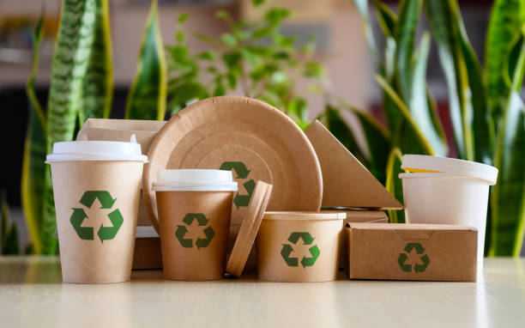
What is green packaging?
Green packaging is packaging that has a minimal impact on the earth. It is also kmown as the sustainable or eco friendly packaging.

Slide 3
How do green packaging be made?
Use sustainable materials: Choose materials that are recyclable, biodegradable, or made from renewable resources. Some examples include recycled paper, cardboard, glass, and certain plastics like PET or HDPE.
Use biodegradable alternatives: Consider plant-based plastics, compostable materials, and biofilms as alternatives to traditional plastics.
Use recycled materials: Use recycled packaging materials to extend the lifespan of previously used items.
Encourage reuse and recycling: Make packaging more durable or attractive so customers can reuse it in new ways.
Reduce packaging size: Reduce the amount of packaging used.
Use eco-friendly void fillers and inserts: Use eco-friendly options for filling and inserting space in packaging.
Use sustainable adhesives: Choose adhesives that are sustainable and can be easily separated.
Create designs that last: Avoid seasonal designs that require products to be recalled or thrown away.
Maintain a sustainable supply chain: Source materials from sustainable and ethical suppliers, reduce inventory and waste, and meet environmental regulations

Slide 4
GREEN PACKAGING FRATURES
GBRYTGH
4Rs
Refuse
Renew
Reduce
Recycle

Slide 5
What makes a package eco-friendly?
Eco-friendly packaging includes packaging that is easy to recycle and made from materials manufactured using minimal impact on energy consumption or natural resources. More often than not, eco-friendly packaging is made from recycled materials. It's commonly referred to as sustainable or green packaging too.

Slide 6
Who is the leader in sustainable packaging?
Smurfit Westrock, a global leader in sustainable paper and packaging, operates in 40 countries with over 500 packaging converting operations and 62 paper mills.

Slide 7
Advantages
Cost Saving
Maintain business
Pack Green
Attract Customer
Increased space

Slide 8
The 3 C’S- innovation in packaging design
CUBE
CONTENT
CURB

Slide 9
Green Packaging Challenges
COST: Green packaging is more expensive than traditional packaging options.
COMPATIBILITY: Green packaging may not be suitable for certain products that require special protection.
LOGISTIC: Implementing green packaging requires changes to logistics & supply chain which can be challenging.

Slide 10
Sustainable plastic packaging market demand MILLION METRIC TONS (GLOBAL)

Slide 11
Sustainable plastic packaging market demand BILLION DOLLARS(GLOBAL)

